Slide 1
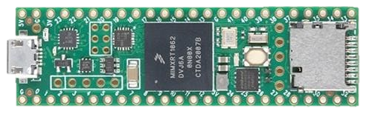

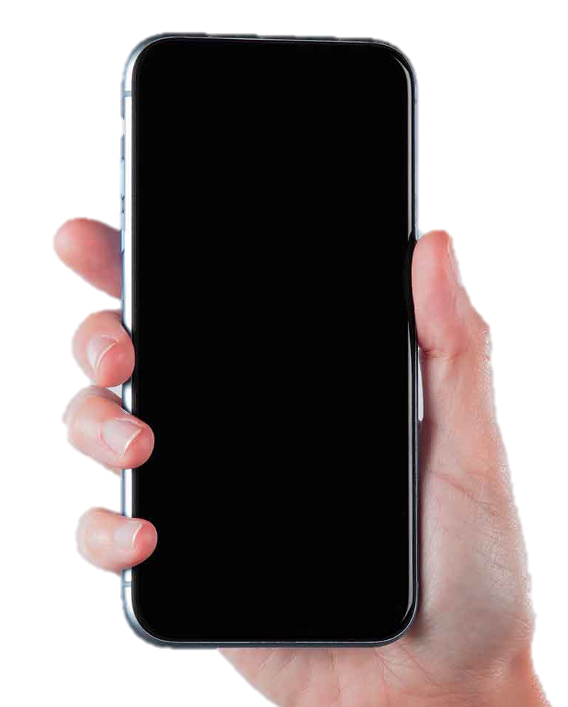
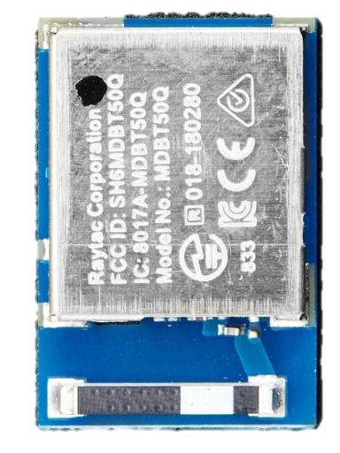
Bluetooth (BLE)
Tympan Rev F
Serial (UART)
Teensy 4.1
nRF52840
Change Software via USB
Change Firmware via J-Link (or OTA)

